Slide 1
Marketing & Advertising I Social Media
Riley Wilson
Director of Marketing
OHI
Notes:
Welcome! You’ve been sitting a WHILE so let’s

Slide 2
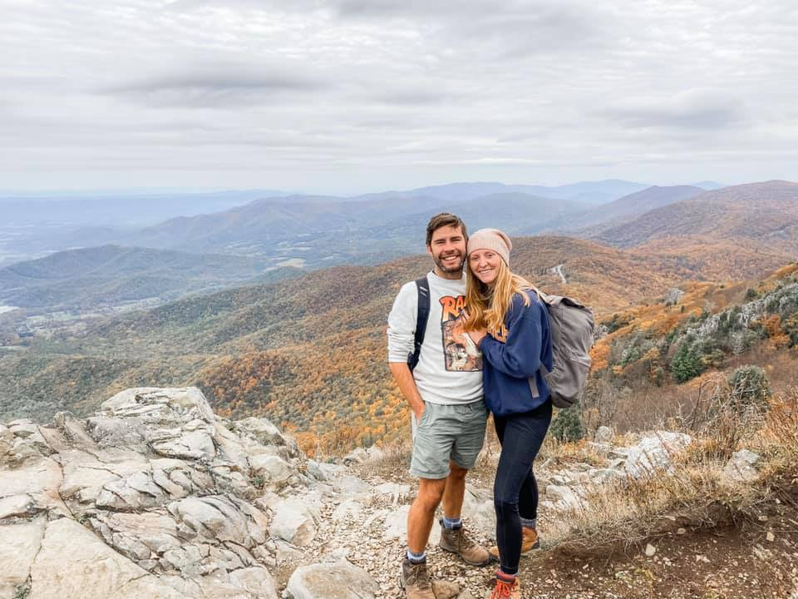
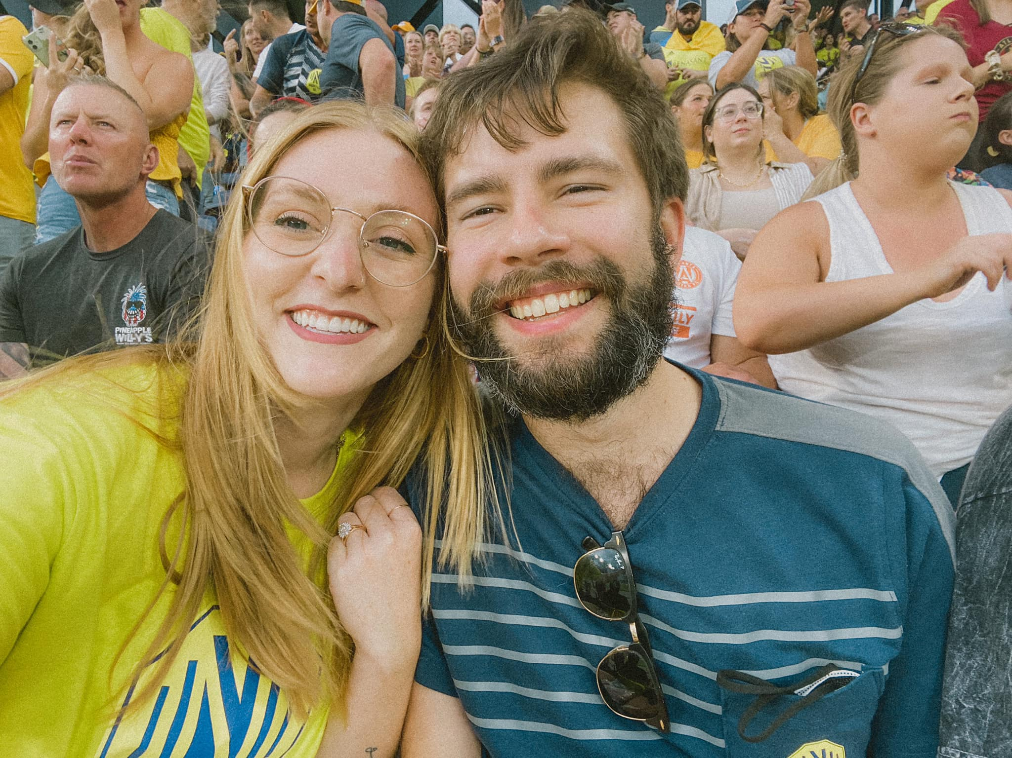
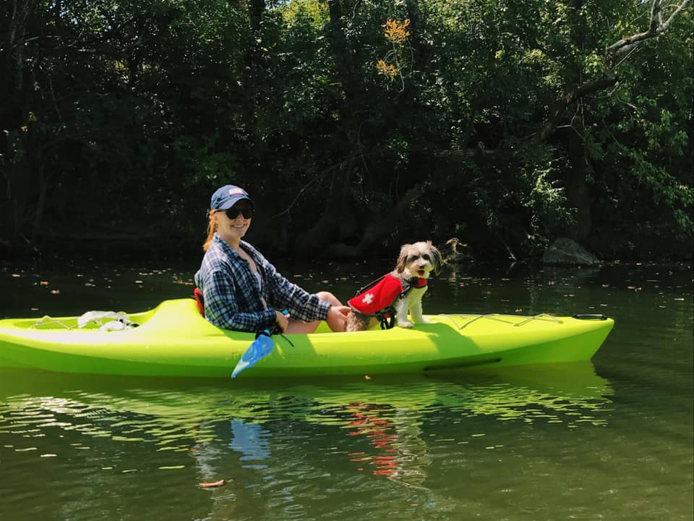
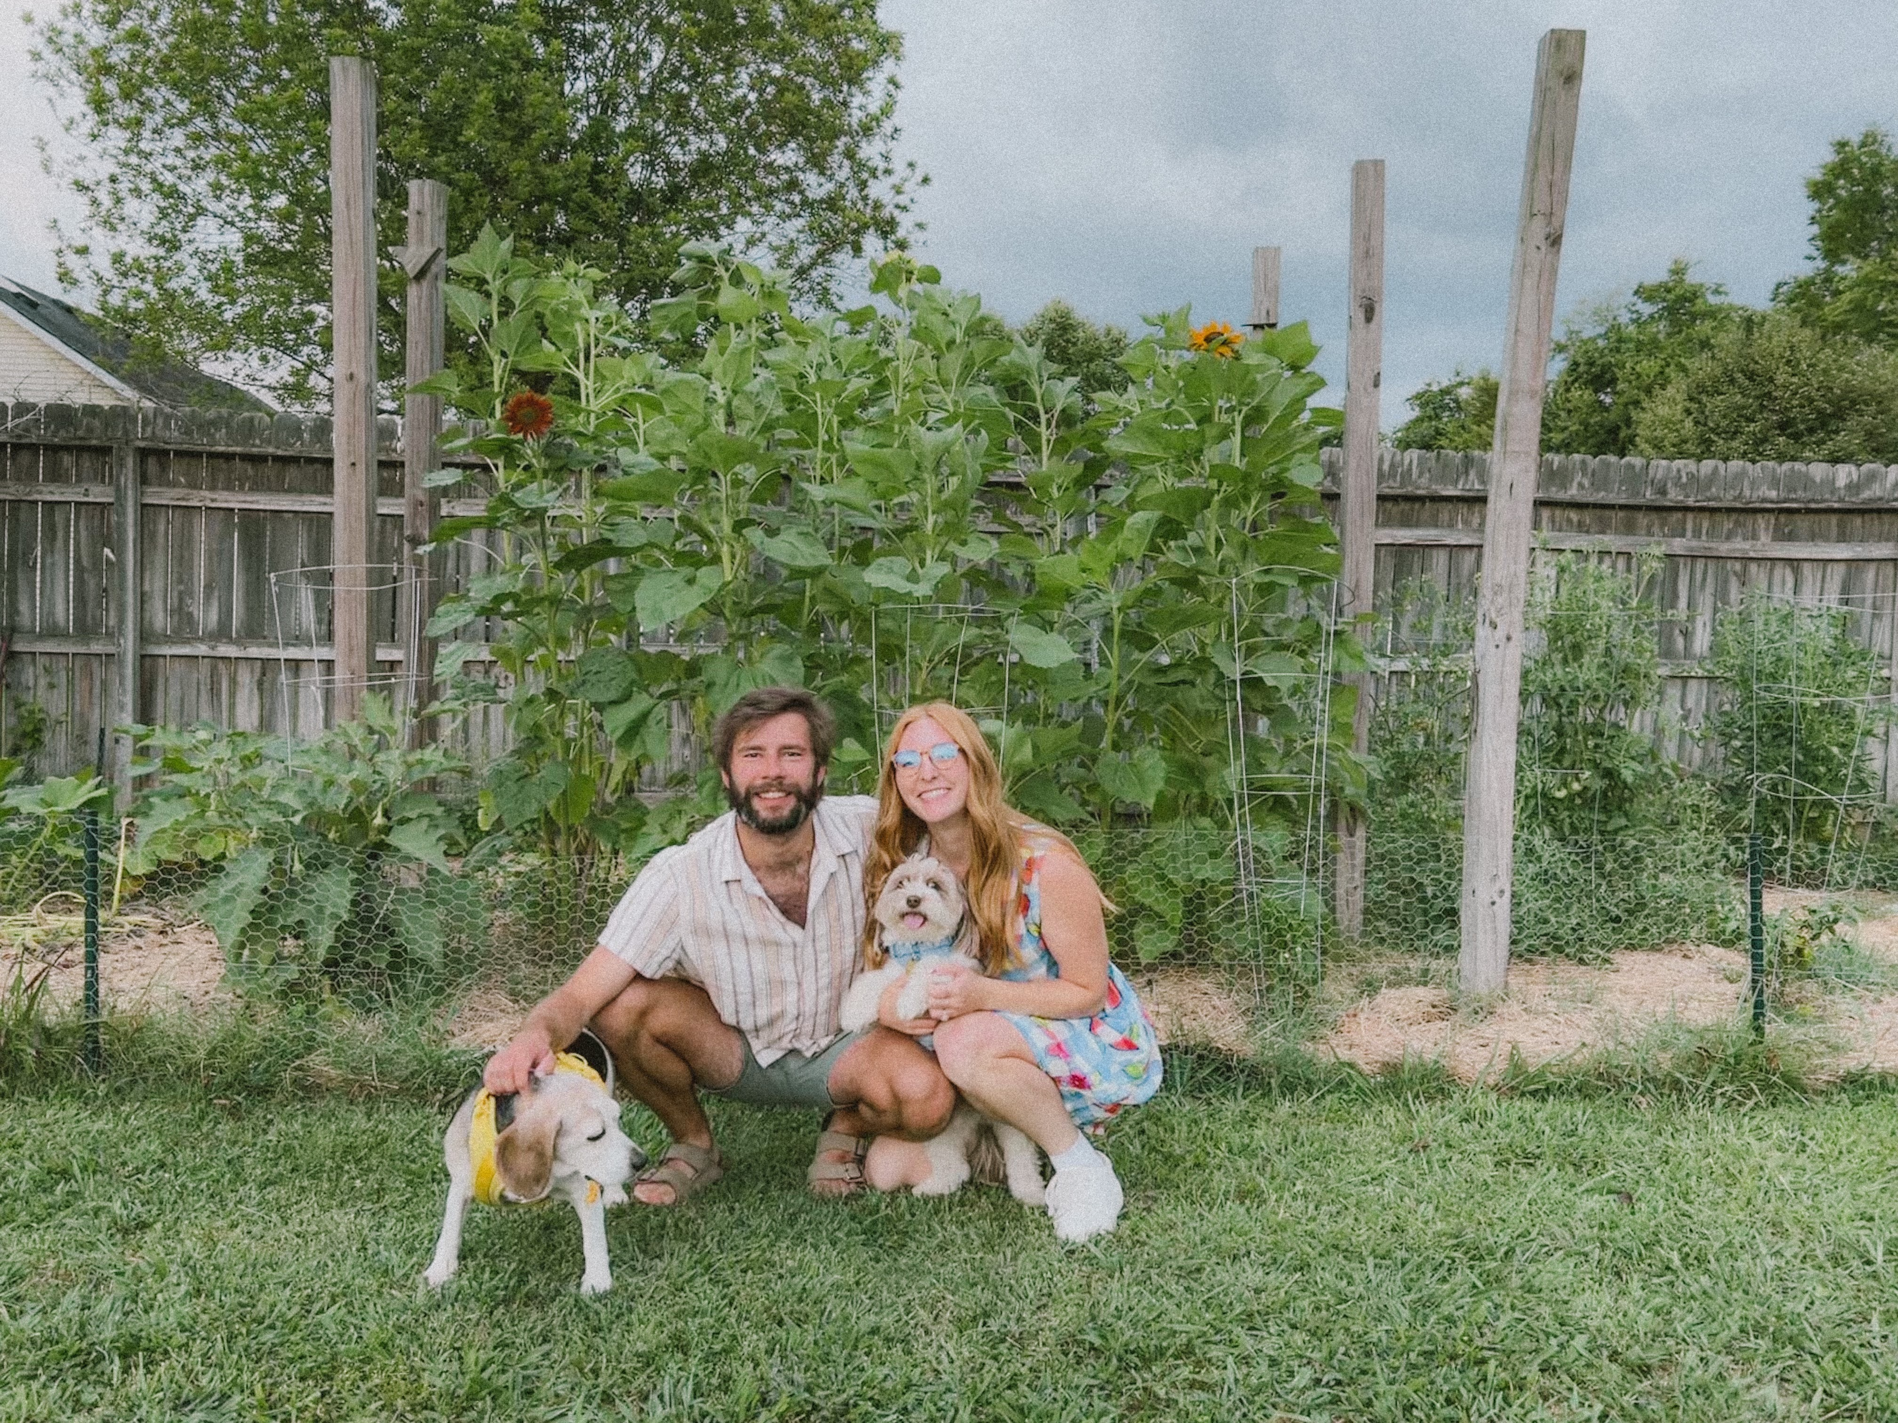
Riley Wilson
Director of Marketing OHI
Cut teeth in ad agency world before joining OHI in 2021
Millennial with a Gen-Z ✨spice✨
Creative problem- solving approach to marketing has guided multiple award-winning campaigns
Notes:
My background is as a digital marketing manager. I made my bones in the advertising world at a full-service agency. When you came into any organization as a young person in the 2010’s you were automatically put on social media duty. Lucky for me, I loved that world. I built our agencies digital department from managing a few organic social to building digital marketing strategies from the ground up for large and small businesses and helping them find success on the internet, whatever that needed to look like. I could talk about digital marketing all day and the cool things you can do, but today I really to focus on giving you all an easy solution to scaling your organic social media marketing.

Slide 3
Who dat?
Notes:
So who is in here?
What is your role in the marketing? What does your marketing team look like?

Slide 4
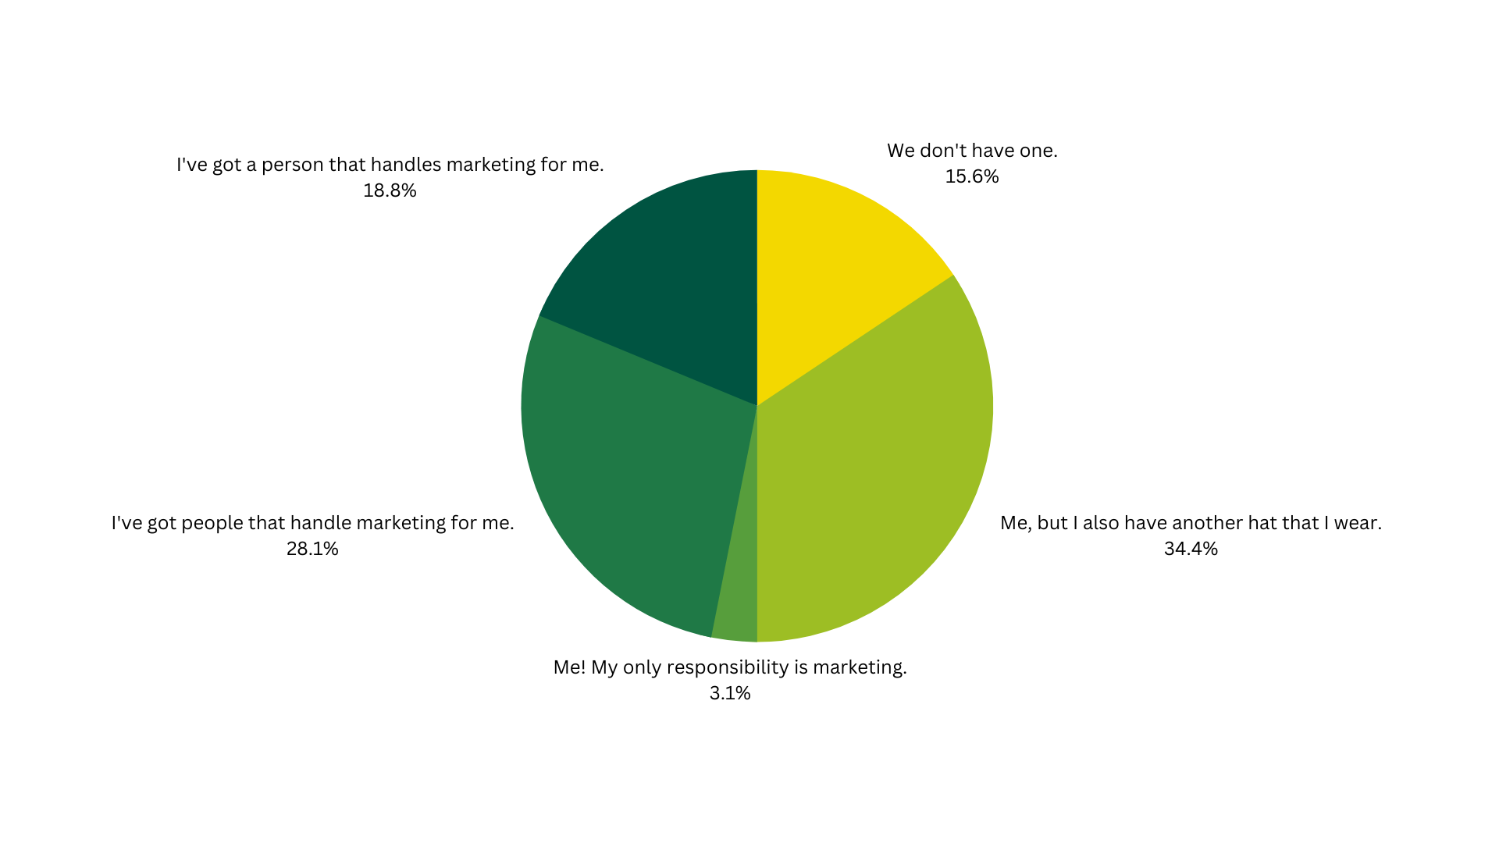
What does your marketing team look like?
Notes:
So this was the year 1 survey last year, so I’d expect it’s fairly similar this year but I want to get a proper feel for the room
Does this ring true by a show of hands?
Also to show you that you’re not alone in your situation. If nothing else let this normalize where you are and what others are doing.

Slide 5
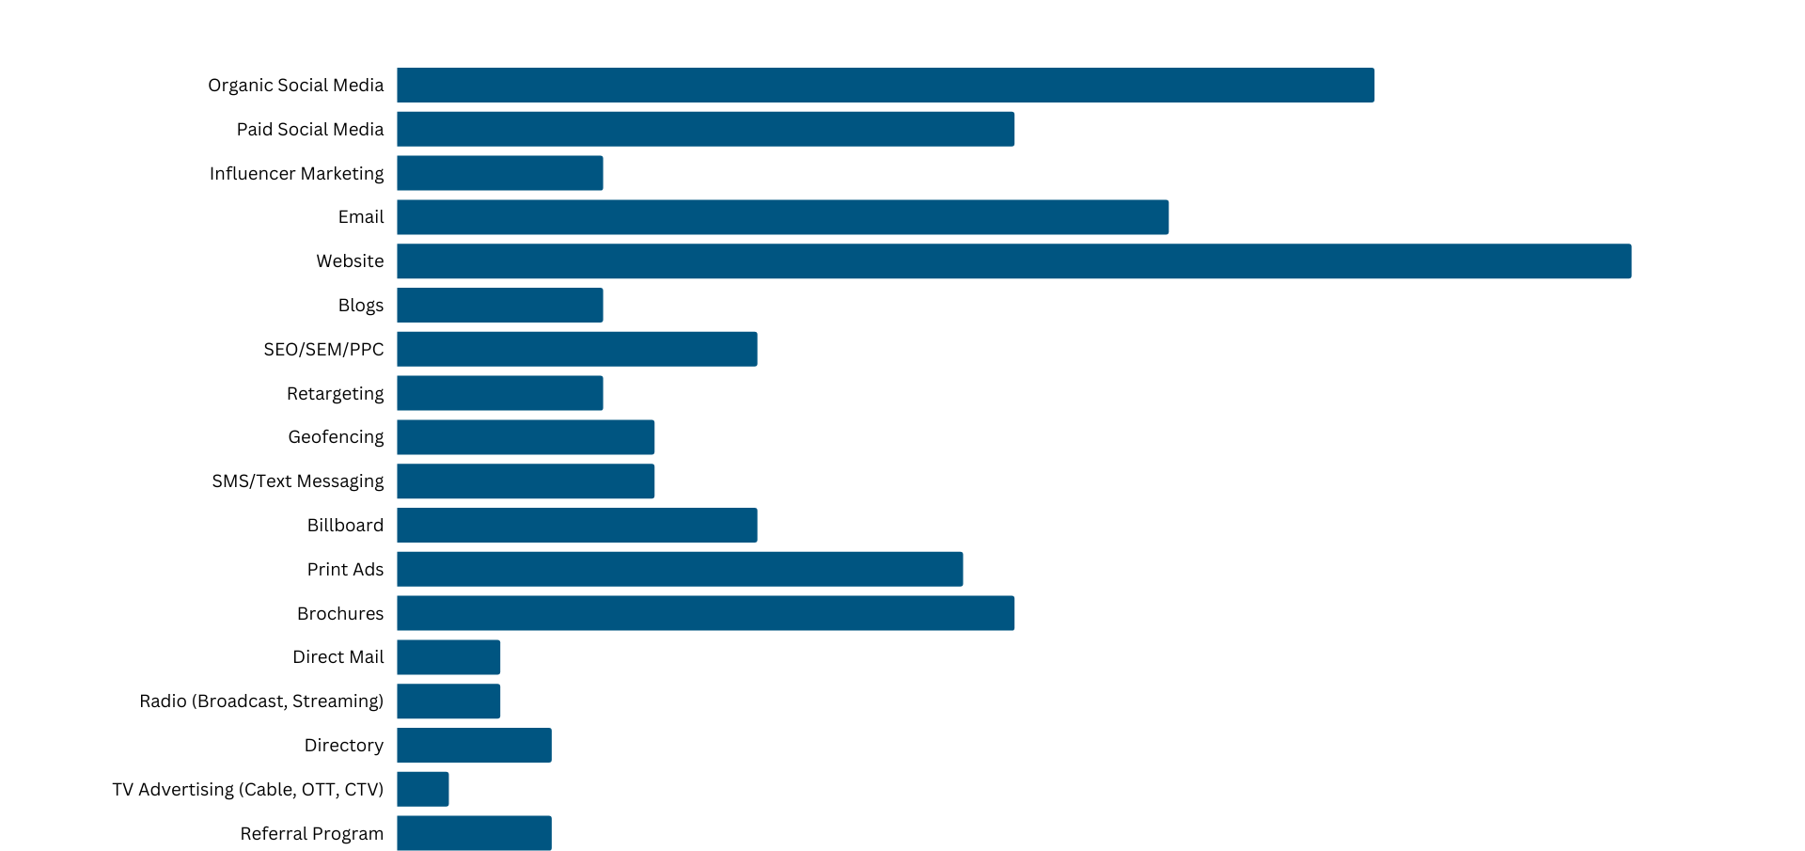
How are you currently marketing your park?
Notes:
This was what the results were from year 1 last year of the tactics being used to market your park. Social being at the tippy top because it’s’ easy. But if you see this list and think “oh shit I am not doing all that” do not panic. Today is about strategizing and realizing you can’t be everything to everyone and everywhere if you want to be successful. We’re focusing on social today.

Slide 6
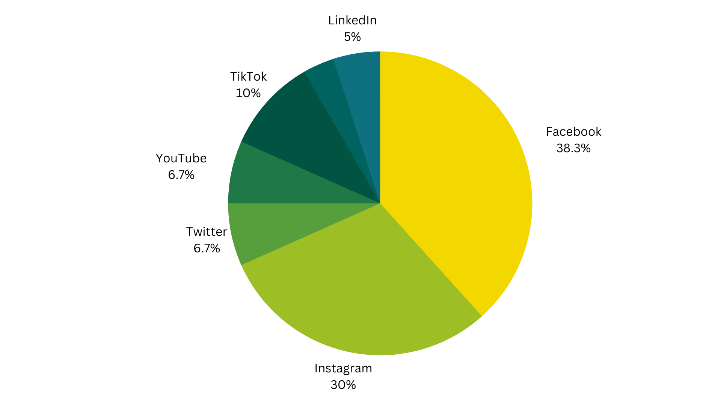
Which social platforms are you currently using for your business?
X/
Notes:
This was what the results were from year 1 last year of the tactics being used to market your park. Social being at the tippy top because it’s’ easy. But if you see this list and think “oh shit I am not doing all that” do not panic. Today is about strategizing and realizing you can’t be everything to everyone and everywhere if you want to be successful. We’re focusing on social today.

Slide 7
So what’re we gonna learn?
An Update on the Landscape
Choose Your Channels
Strategizing for Success
Content Calendaring, Creation, & Tools

Slide 8
So why social?
Notes:
So why organic social?
I could ramble on, but let’s suffice to say
Cheap
Easy
Creative
&
Effective
Cheap: you can do it affordably. You can do it expensively. But you can also do it affordably. For businesses of all shapes and sizes though, there is a cheap option. The caveat to this is having a person to dedicate time to it.
Easy: by easy, i mean low barrier to entry. You’re not having to learn all about how Google campaigns work, and setting up your tags correctly or finding a broadcast or OOH rep that’s gonna do you a solid on rates. It’s an owned media source that is super easy to set up and manage.
Creative: your social can be boring, but it shouldn’t be. And it doesn’t have to be. And it doesn’t take a lot for it to not be boring. Boring ads fail 100% of the time.
Effective: I have always suggested that clients have an organic social media presence because it works. But there is a key to being effective and it’s not the kitchen sink approach. It’s all about picking and choosing.
COMMUNITY
"Unlike traditional advertising, which is designed to interrupt and stand out, native advertising is designed to blend in and promote your brand to a new audience who might otherwise never learn about you." https://blog.hubspot.com/marketing/marketing-trends "n fact, consumers view native ads over 50% more than banner ads." https://blog.hubspot.com/marketing/marketing-trends
As digital natives grow as decision-makers, we’re seeing changes to how buyers interact with businesses online. Some of the biggest social challenges are coming up with ideas, creating engaging content that generates leads, and gaining followers. Facebook, Instagram, YouTube, and TikTok have the strongest ROI — and these align with where marketers are investing in 2024. Twenty-seven percent of marketers who don’t use YouTube plan to start in the year ahead. For those curious, 68% of marketers predict more success with X than Threads in 2024.

Slide 9
The State of Social
Roughly 82% of Americans between 18 and 49 years old use at least one social media site. (Pew Research Center)
Americans check their social media on average for 2 hours and 23 minutes per day.
53% of consumers say their social media usage has been higher over the last two years than the previous two
Everyone is on Facebook, but what does that mean?
Notes:
Social is a search engine.
Decision makers are going to social for everything — search, sales, and service.
Embrace individual personalities and creators. Invest in Facebook, Instagram, and YouTube and make it easy to buy from your brand on social.
"56% of U.S. consumers said they bought something based on an ad they saw on TikTok, and 36% said they were willing to." https://blog.hubspot.com/marketing/marketing-trends
Some 78% of TikTok users have purchased a product after watching TikTok creator content about the product.
Social Age gaps are especially large for Instagram, Snapchat and TikTok – platforms that are used by majorities of adults under 30. For example:
78% of 18- to 29-year-olds say they use Instagram, far higher than the share among those 65 and older (15%).
65% of U.S. adults under 30 report using Snapchat, compared with just 4% of the oldest age cohort.
62% of 18- to 29-year-olds say they use TikTok, much higher than the share among adults ages 65 years and older (10%).
Americans ages 30 to 49 and 50 to 64 fall somewhere in between for all three platforms.
YouTube and Facebook are the only two platforms that majorities of all age groups use. That said, there is still a large age gap between the youngest and oldest adults when it comes to use of YouTube. The age gap for Facebook, though, is much smaller.

Slide 10
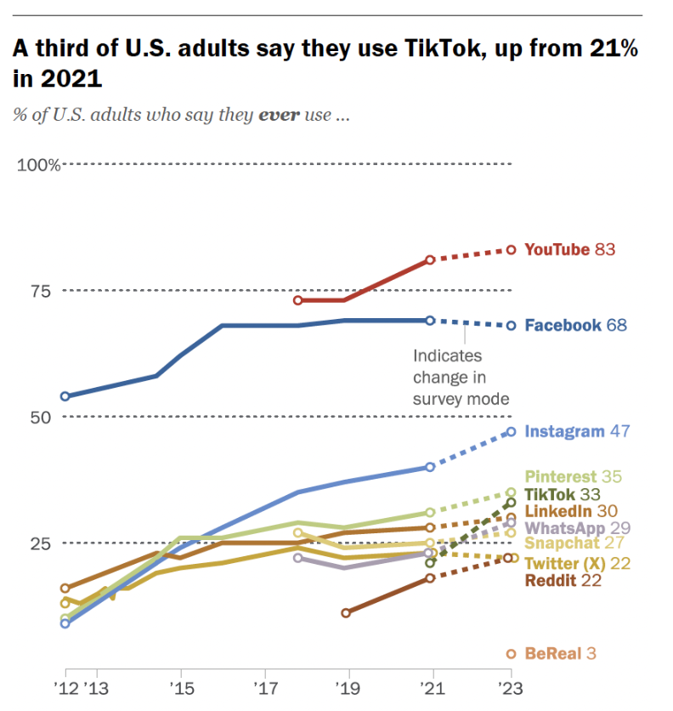
Notes:
Social media is the most preferred product discovery platform for consumers aged 18 to 44 (HubSpot State of Marketing Report, 2023). (Source: https://www.hubspot.com/marketing-statistics)
ORGANIC VS PAId

Slide 11
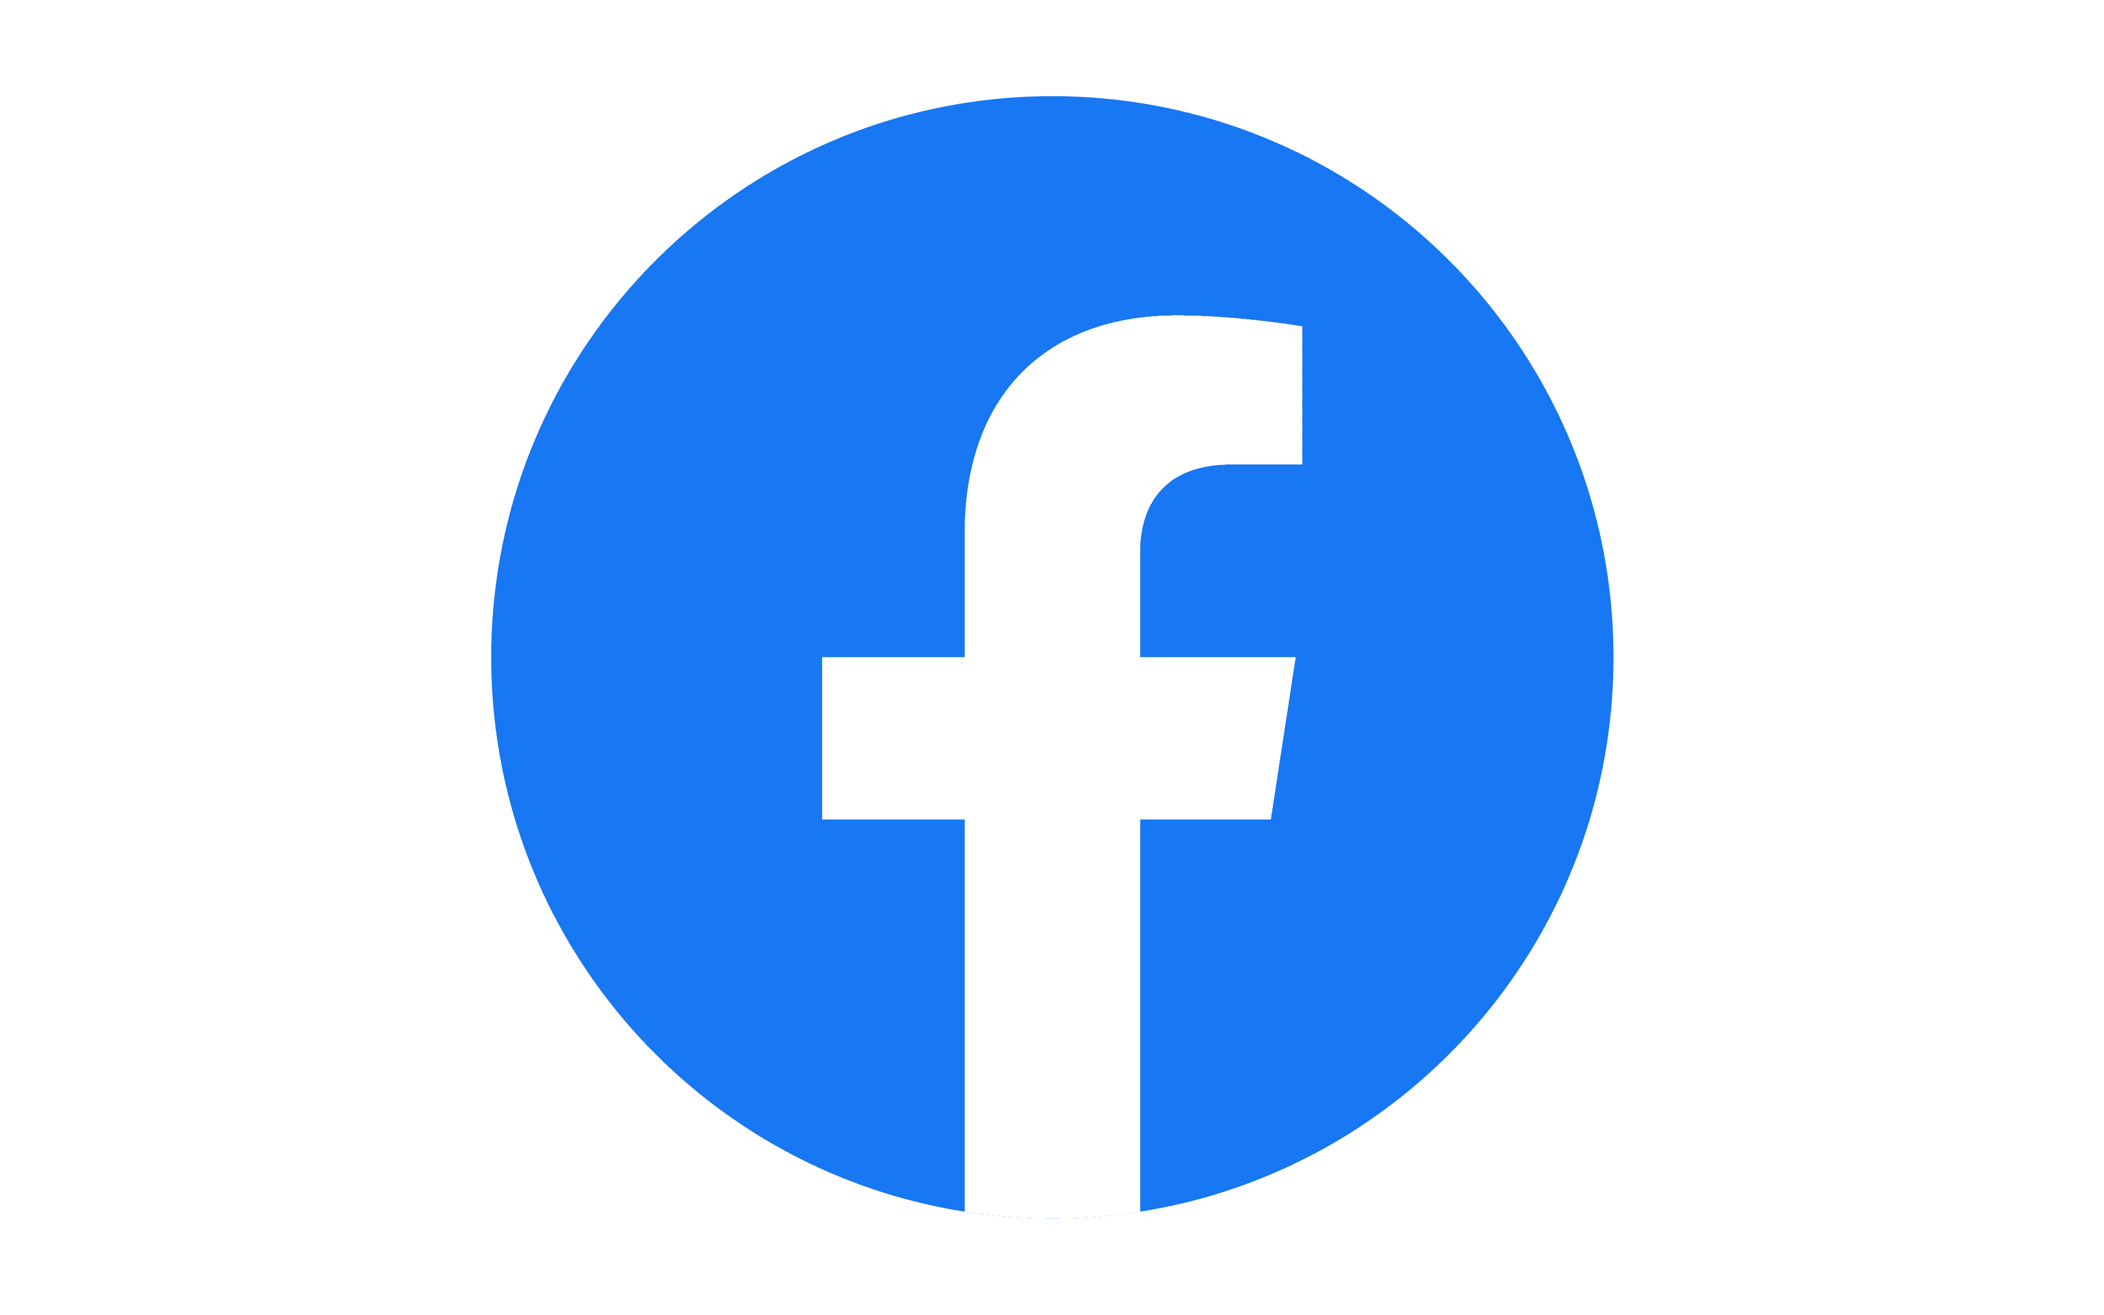
Notes:
The worst advice I can give is that you need to be on all platforms. No. That’s a wide net that’s never gonna catch any fish, and if you’re trying to save time and be the MOST effective pick two platforms.
Case by case depending on what you’re doing. But if you’re just starting out, or even if you’re knee deep into it with four platforms and the creek is rising well God willing get out of a few.
My point is, don’t think you have to be everywhere. You can’t be everything to everybody so be really good at what you’re really good at.
I GIVE YOU PERMISSION TO STOP

Slide 12
Facebook
Facebook is Gen X and Baby Boomers favorite social media platform. (HubSpot Blog Research)
91% of Baby Boomers, 88% of millennials, and 83% of Gen X have visited Facebook in the last three months. (Hubspot Blog Research)
31% of U.S. adults regularly get news from Facebook. (Pew Research Center)
Only 12% of Gen Z-ers say they use Facebook more than any other platform. (HubSpot Blog Research)

Slide 13
Instagram
84% of teens in the U.S. use Instagram at least once a month.
Nearly 60% of the global Instagram population worldwide is aged 34 years or younger.
Males between the ages of 18 to 24 represent the largest demographic on Instagram, followed closely by males between 25 to 34 years old. (Statista)
In the past few months, 55% of Gen X-ers and 27% of Baby Boomers have visited Instagram. (HubSpot Blog Research)
Instagram has the highest ROI, engagement, and highest quality leads. (HubSpot Blog Research)
Notes:
The audience is a near even split, meaning the platform isn’t inherently better for reaching one demographic audience over another.

Slide 14
TikTok
TikTok users are twice as likely as users of other social channels to recommend something they found on the platform. (TikTok)
36% of consumers want to learn about products through short-form videos like TikTok. (HubSpot Blog Research)
21.5% of TikTok’s global audience are women between the ages of 18 and 24 and 17% are male users between 18 and 24. (Statista)
On average, adults residing in the United States devoted 46 minutes daily to using TikTok.

Slide 15
YouTube
YouTube is the second most visited website in the U.S. (Semrush)
A quarter of U.S. adults regularly get news from YouTube. (Pew Research Center)
YouTube is almost equally as popular with Gen Z, Millennials, and Gen X audiences. (HubSpot Blog Research)
YouTube is Baby Boomers second favorite social media app. (HubSpot Blog Research)
Gen Zers (18-24)’s second most popular way they discover new products is from YouTube ads. (HubSpot Blog Research)

Slide 16
Twitter/ X
Twitter is the seventh most visited website in the U.S. (Semrush)
There are 347,200 Tweets sent per minute on Twitter. (Statista)
As of December 2022 Twitter’s audience is over 368 million monthly active users globally. (Statista)
The average amount of time per day spend on Twitter is 31 minutes. (Statista)

Slide 17
Pinterest
Every month 460 million people use the platform.
People come to Pinterest looking for inspiration and trip planning. Traffic coming from the site leads to more opt-ins, conversions and sales than from other social media platforms. 87% of survey participants revealed that using Pinterest affected their purchasing decisions.
12.5x increase in searches on Pinterest year over year for “RV camping tips” 2020
Searches for “travel inspo” increased by +87% during mid-March to mid-April alone and are continuing to rise. 2022
45% of Americans with a household income of more than $100,000 use Pinterest.

Slide 18
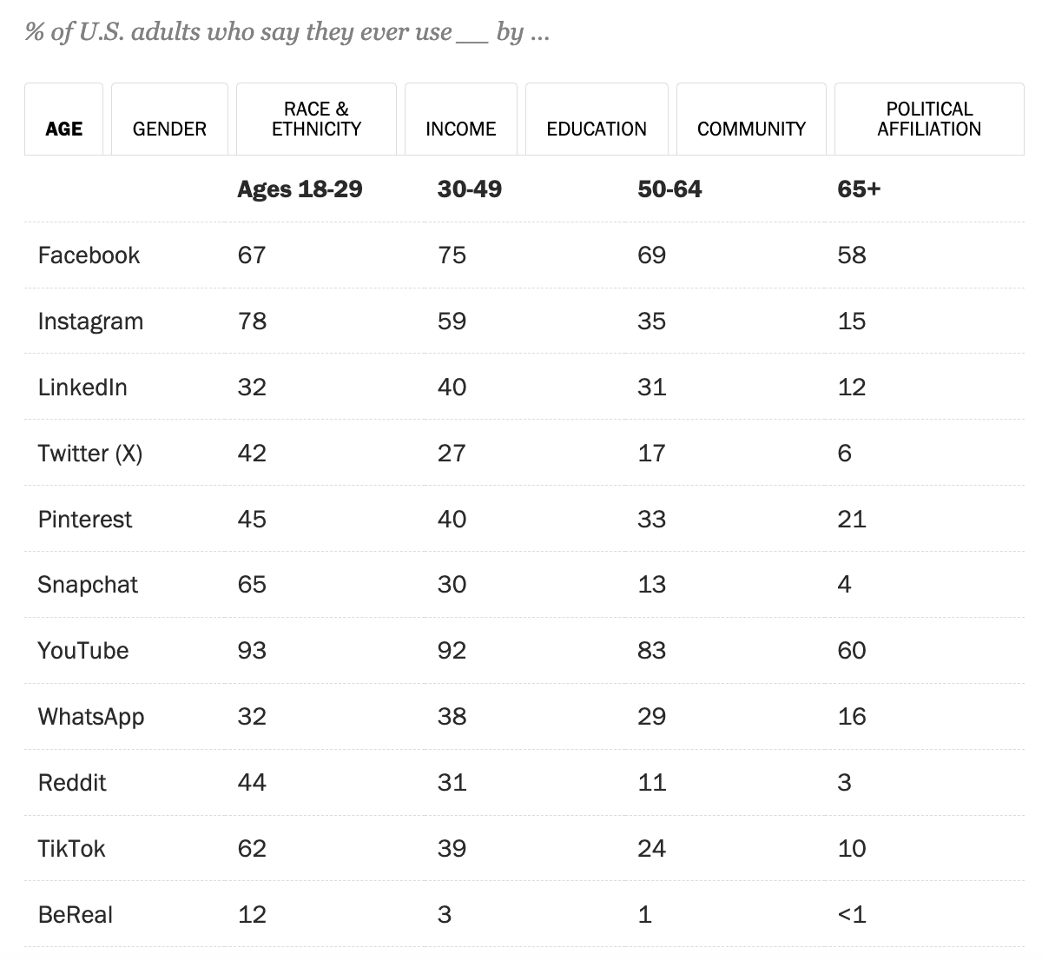

Slide 19
Strategizing for Success

Slide 20
What’s your WHY?
Your strategy statement is a synopsis of your social media marketing plan. It should be short and establish what you want to achieve with your presence on social media. It's your purpose.

Slide 21
Sample KPIs
If you don’t measure it, it don’t matter.
Impressions:
What is it? How many people saw your posts
Example KPI: Reach at least 1,000 unique users for every post
Shares:
What is it? How many people shared your posts
Example KPI: 20 shares for every post
Click-through rate:
What is it? How often people are actually clicking links in your posts
Example KPI: Average of 40% click-through rate per post
Engagement:
What is it? A combination of likes, shares, follows, and anything where a person engaged with a post or your account
Example KPI: 10% more overall engagement than prior campaign
Conversions:
What is it? How many people converted after engaging with your post
Example KPI: Have 25% of website sales originate from social media

Slide 22
You’re being audited.

Slide 23
Content Calendaring, Creation, & Tools
Notes:
Make it doable. Don’t overwhelm yourself. Can you make one reel

Slide 24
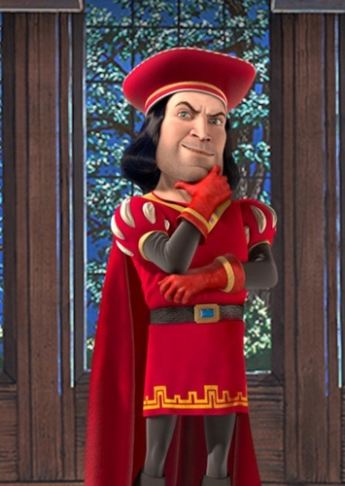
Short
Kings
Notes:
TikTok, the pioneer of the short-form video content movement, has been the fastest-growing social media platform thus far, generating 1.53 billion users in just seven years
96% of consumers prefer to watch short-form video to learn about a product or service
Short-form video has the highest ROI as well as being the best format for lead generation and engagement
Nearly a third (30%) of all short-form videos are watched 81% of the way through
47% of marketers agree that short-form videos are more likely to go viral
On average, adults residing in the United States devoted 46 minutes daily to using TikTok. It is projected that by 2024, the average daily usage time of the social short-video platform by U.S. adults will increase to 48 minutes
1. Pay Attention to Popular Trends
In order to create content that fits on the short-form video platforms, you need to first dedicate time to consuming content on these platforms. This is the fun part, but make sure you still spend your time wisely.
2. Start With a Hook
The nature of these short-form video platforms is that users scroll up to quickly go from video to video. This means it’s extremely easy for viewers to scroll past your video if it doesn’t immediately draw them in. To combat this, start with a hoo
3. Create Relevant Content
Regardless of whether you choose to add a music clip or a trending sound byte to your videos or choose to create completely original content, you need to make sure it’s still relevant to your brand and the type of content your target audience would want to see from you.
4. Repurpose Long-Form Videos
If you’ve previously invested in a log of long-form videos, use those! You can easily crop the footage to fit a vertical screen and pick clips out from your longer videos using a video editing tool. This is a great way to start publishing short-form content while still finalizing your strategy and brainstorming ideas.
5. Keep it Less Than 60 Seconds
While some videos, like in-depth tutorials or stories, might make it to the 3-minute TikTok limit, the best case scenario is less than 60 seconds—or even sometimes less than 15 seconds. This makes sure your video really is bite-sized.
6. Share Consistently
If you want results from your short-form video content, you have to post new videos regularly. Aim to post once per day, or at the very least once per weekday. This will make sure you have enough content for the algorithm to choose from and show to your target audience.
7. Promote Across Platforms
We’ve mentioned this earlier, but it’s key: you don’t need to create separate strategies for TikTok, Instagram Reels, and YouTube Shorts. While you might choose to share certain videos on only one of those platforms, you can easily share your short-form videos across the three platforms, as well as on your Instagram Stories, Facebook Stories, or even Twitter account
8. Record Vertically
Short-form video platforms are meant to be viewed on mobile devices in a vertical format. While repurposed long-form content can be cropped into a vertical format, your best bet when creating new short videos is to record vertically so you don’t have to worry about that. Plus, the last thing you want to do is post a horizontal video on a vertical platform—your audience won’t be able to see the video as easily and it won’t be as attractive on their screen.
9. Use Your Caption Strategically
While you don’t have a ton of space in your caption, it’s still a great place to provide additional context to your video, so use it wisely. You can include a call-to-action, share more information not covered in the video, and more.

Slide 25
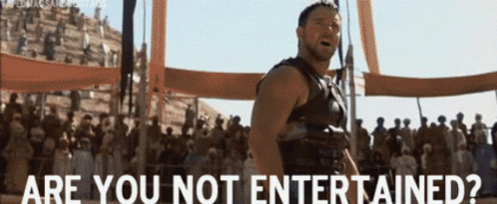
Notes:
People want to be entertained.
Aside from friends and family they want entertainment
80/20 rule
And you know what else they said? That they don’t like it when brands are too focused on self-promotion. In fact, 34% say it’s a major turn-off in how they perceive brands on social

Slide 26
The best marketing doesn’t feel like marketing.
Notes:
COMMUNITY
Mission- goals and why Don’t post content just to post content Align with company’s goals Launch a new site type and want to promote that then you can support that goalWhat’s something cool that a lot of people don’t know? And make the goal to be promoting that aligned with the squishy goal of making the world a better placeThe fewer things you have the more clarity you can have to achieve successfully
Influencers How many people know a kid that wants to be an influencer?
In 2023, one in four consumers bought a product based on an influencer’s recommendation.
Invest in long term micro infleuncers
It’s about community

Slide 27
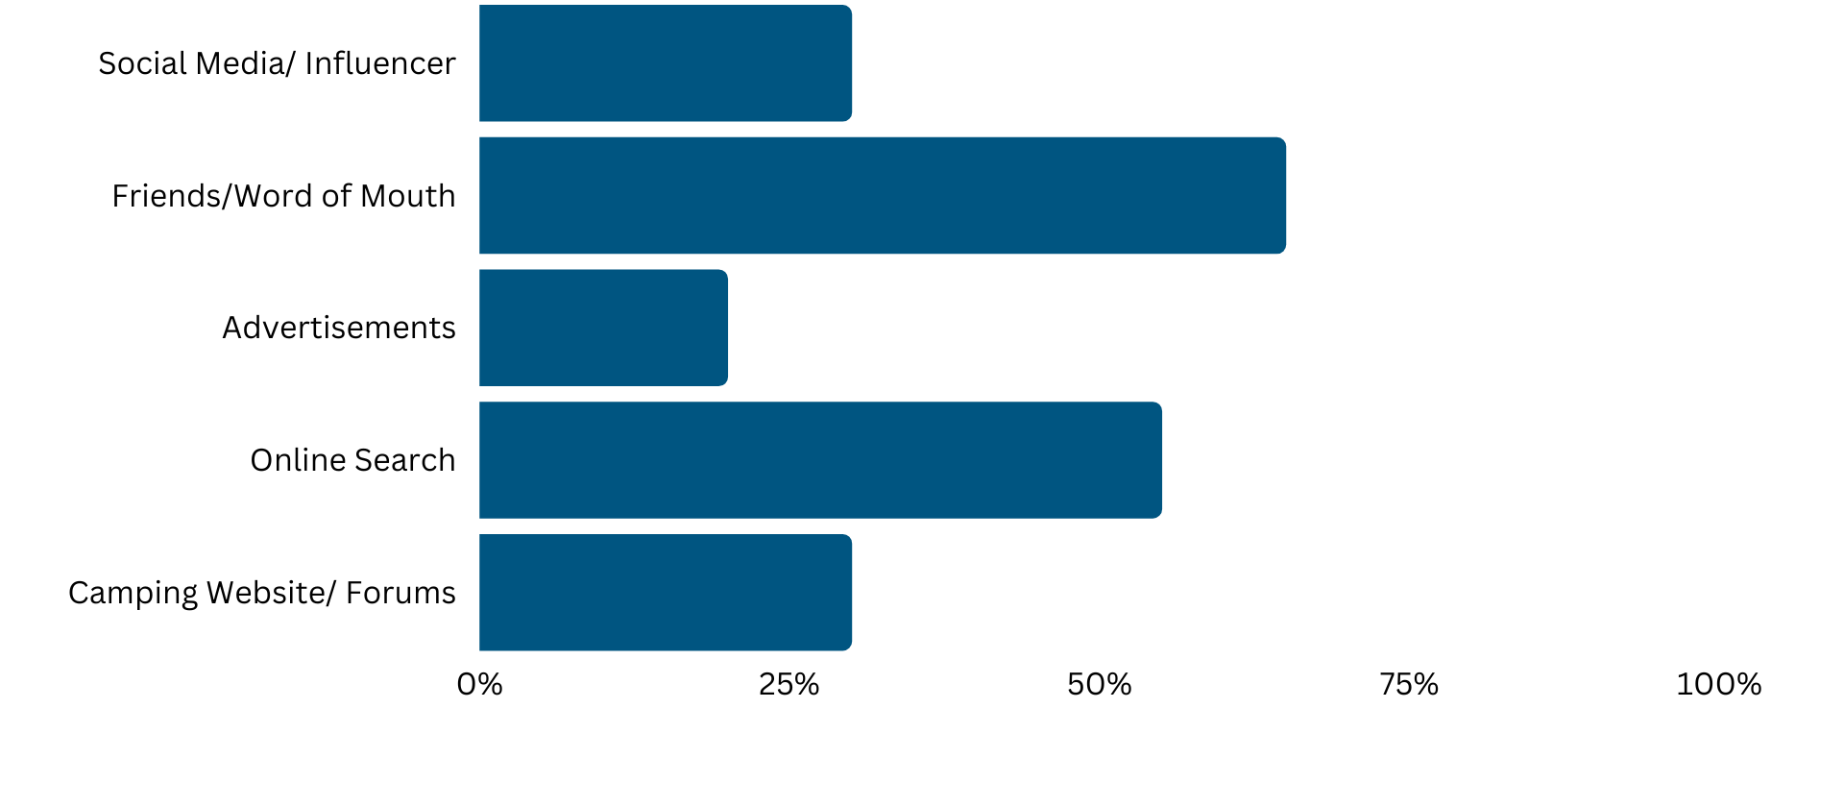
How do you usually learn about campsites?
Notes:
Social is word of mouth

Slide 28
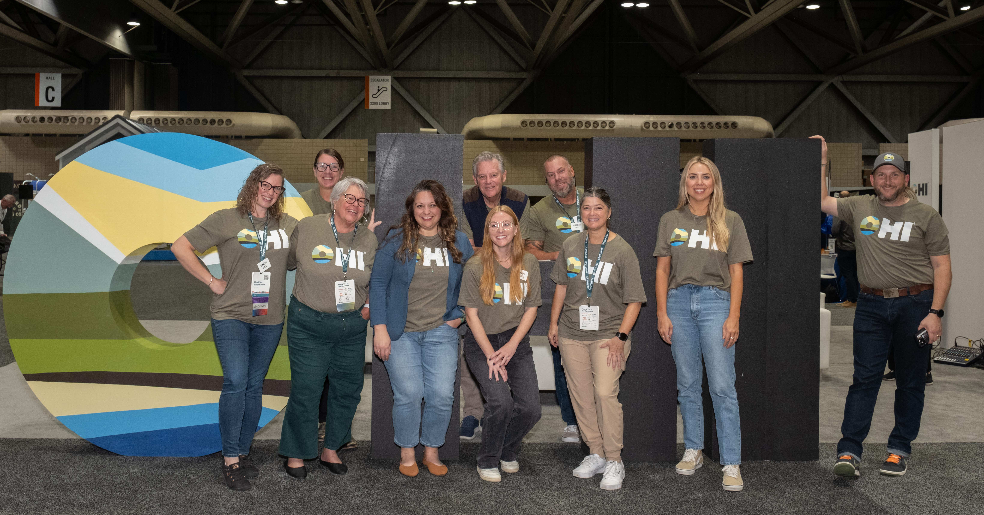
Riley Wilson
Director of Marketing OHI
Riley.W@ohi.org

